Slide 1
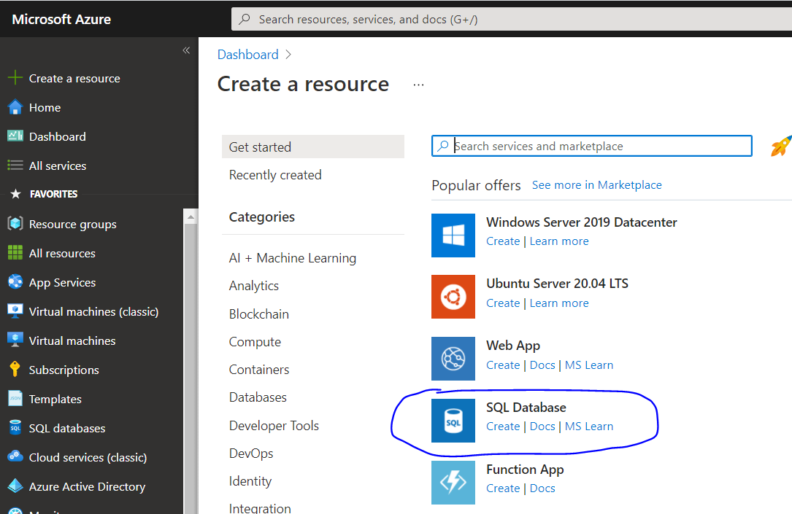

Slide 2
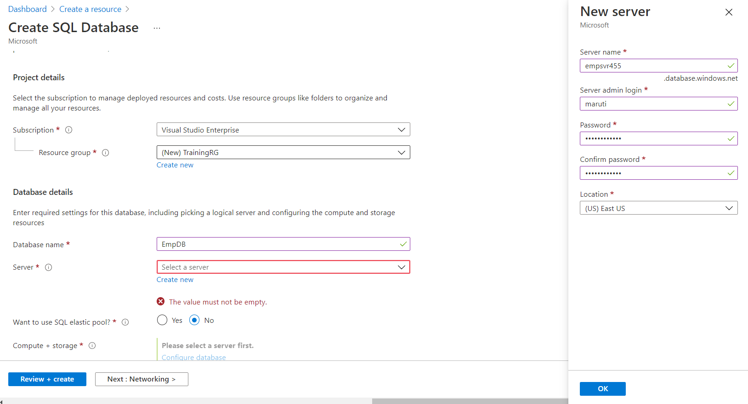

Slide 3
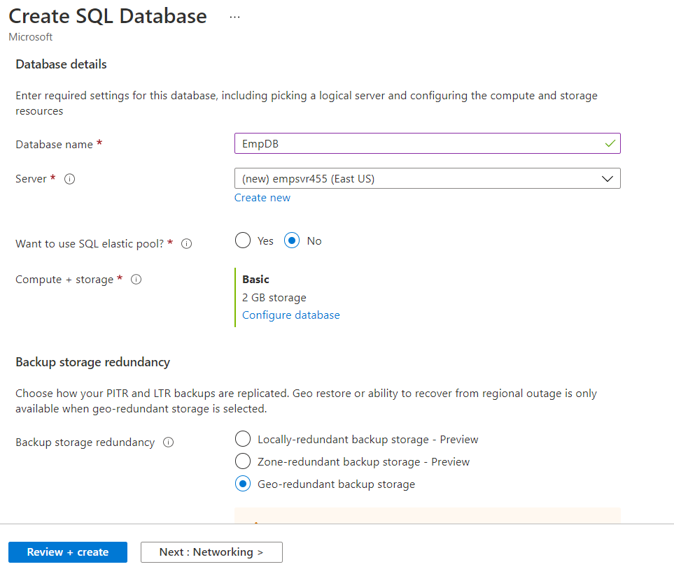

Slide 4
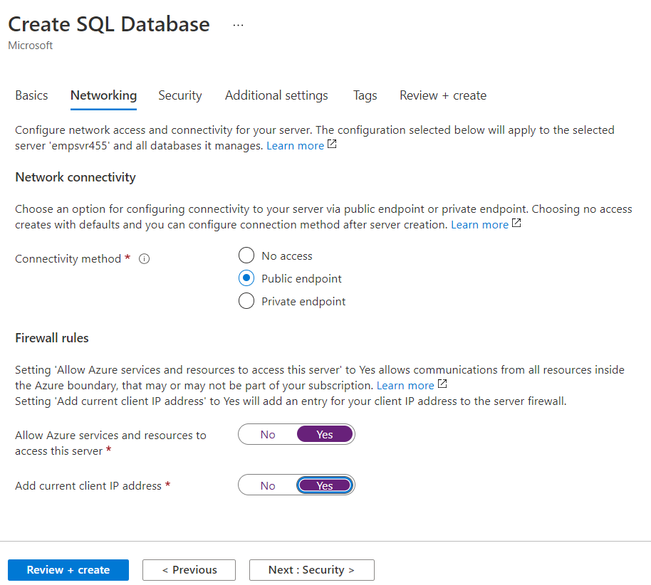

Slide 5
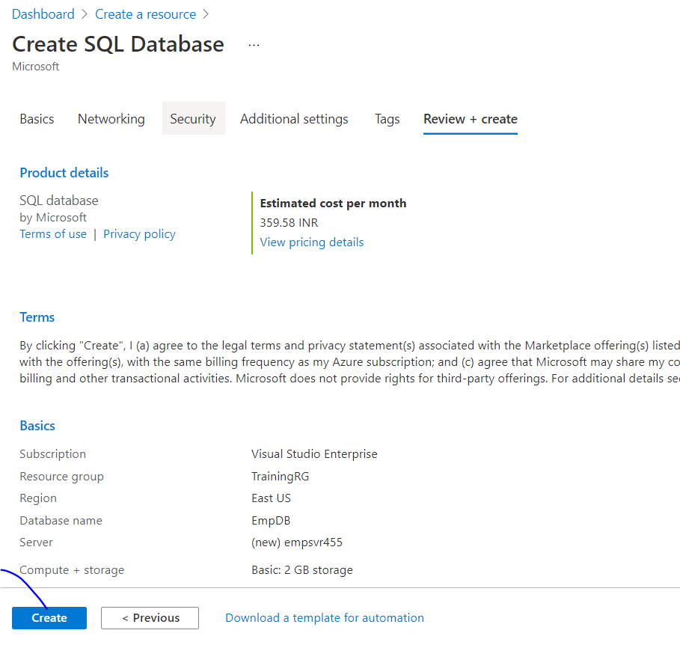

Slide 6
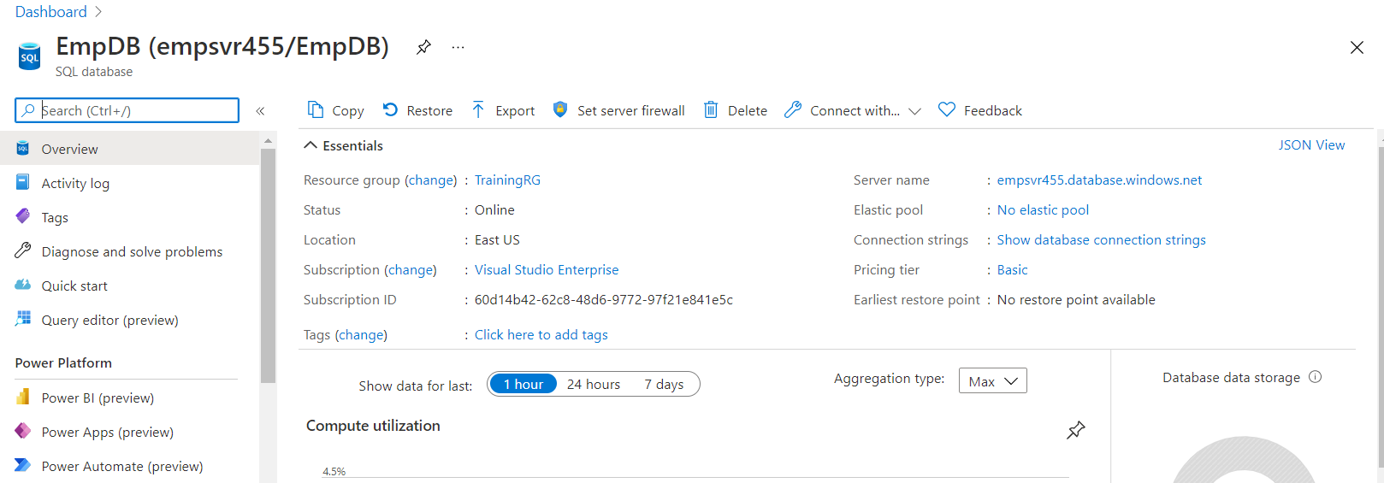

Slide 7
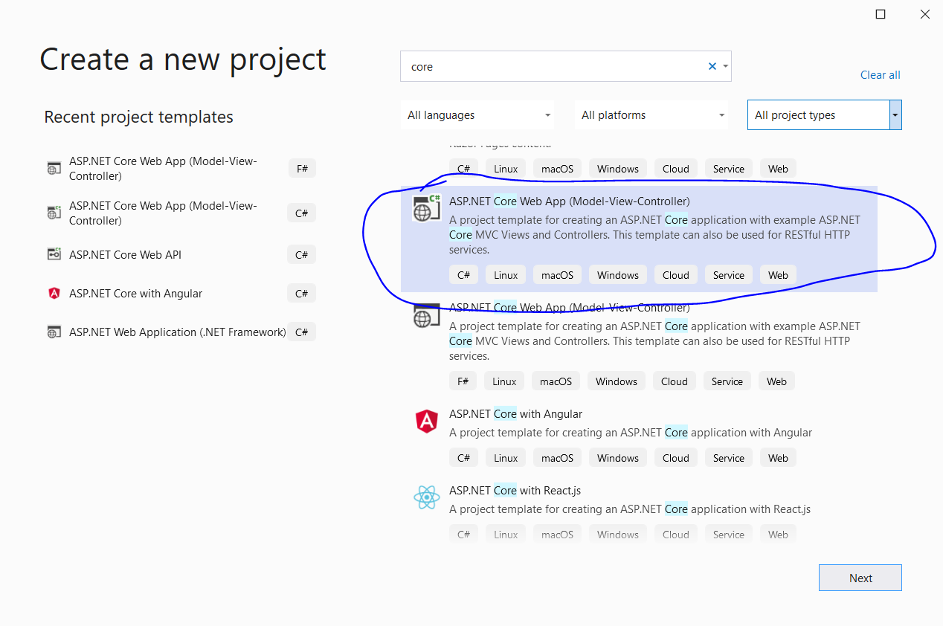

Slide 8
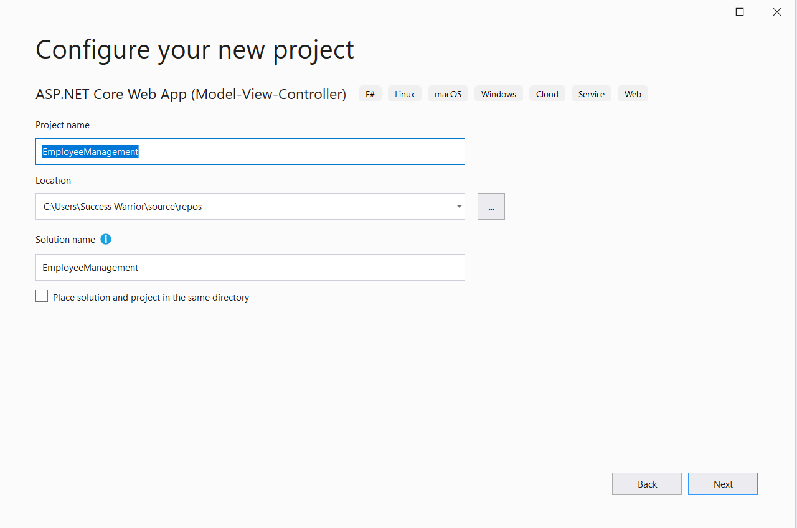

Slide 9
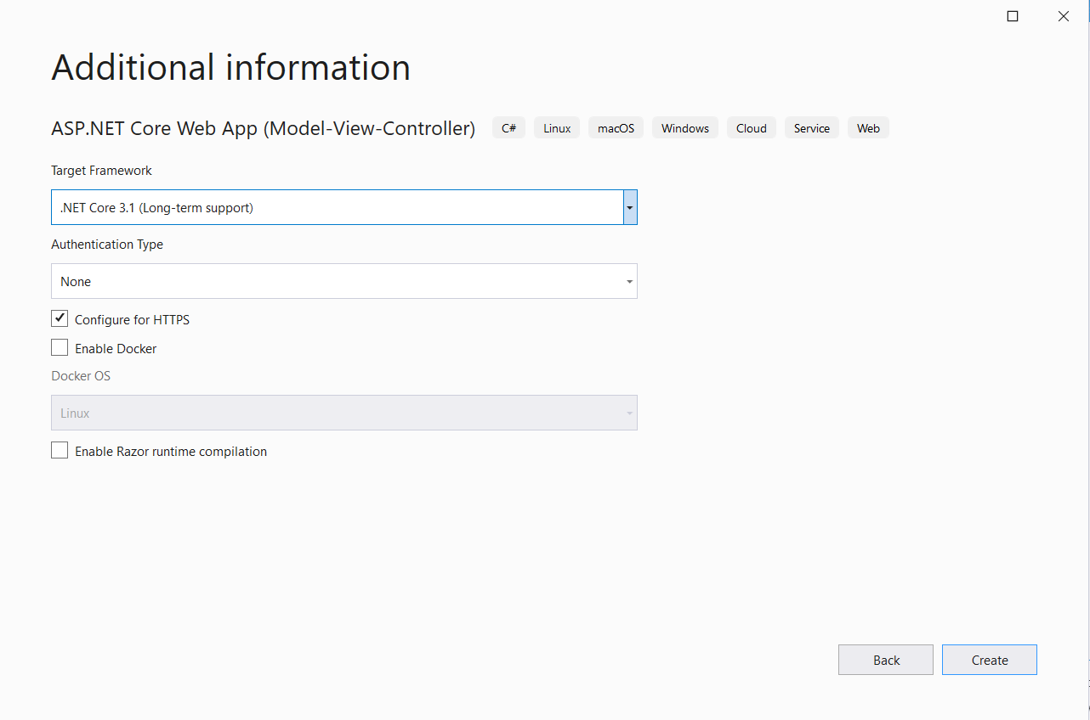

Slide 10
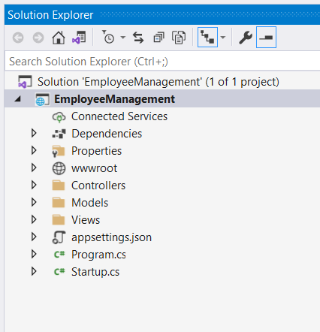

Slide 11
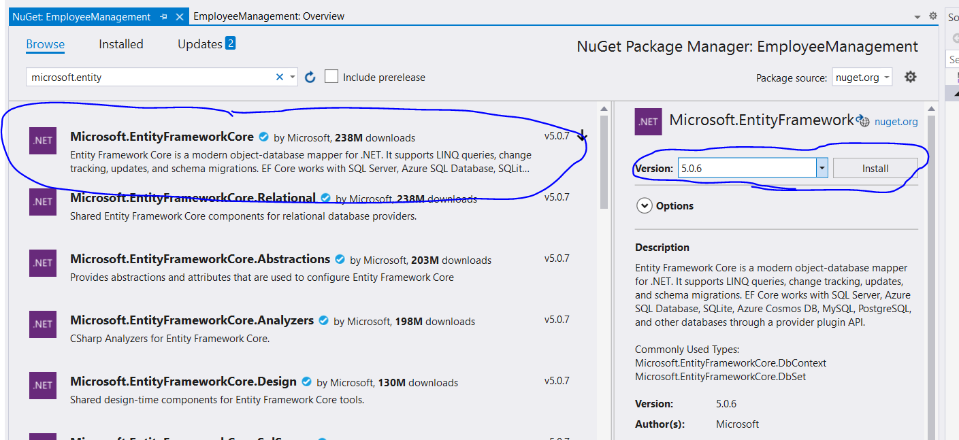

Slide 12
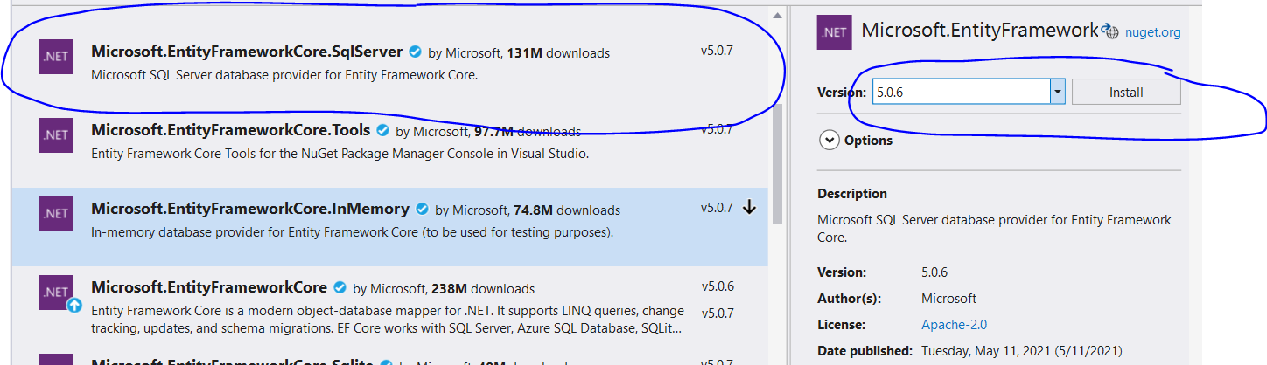

Slide 13
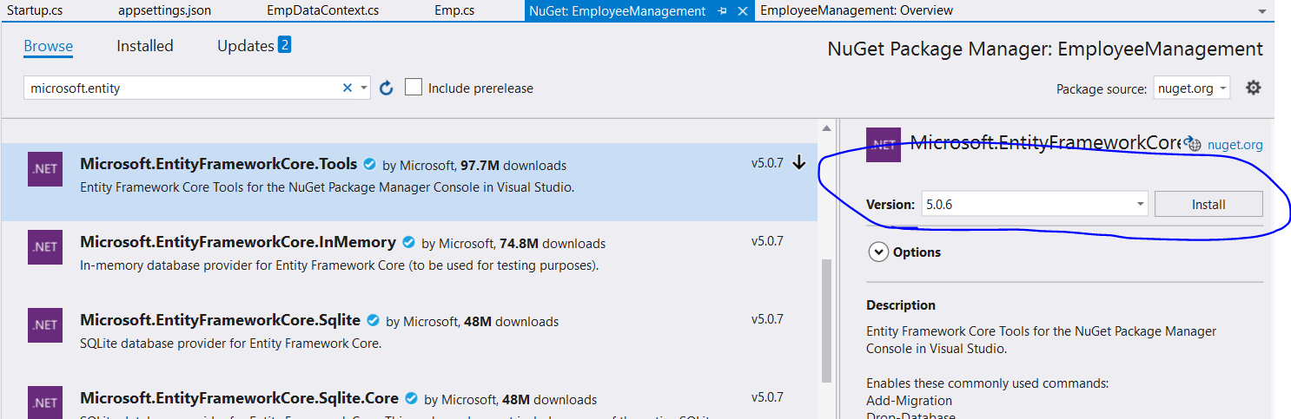

Slide 14
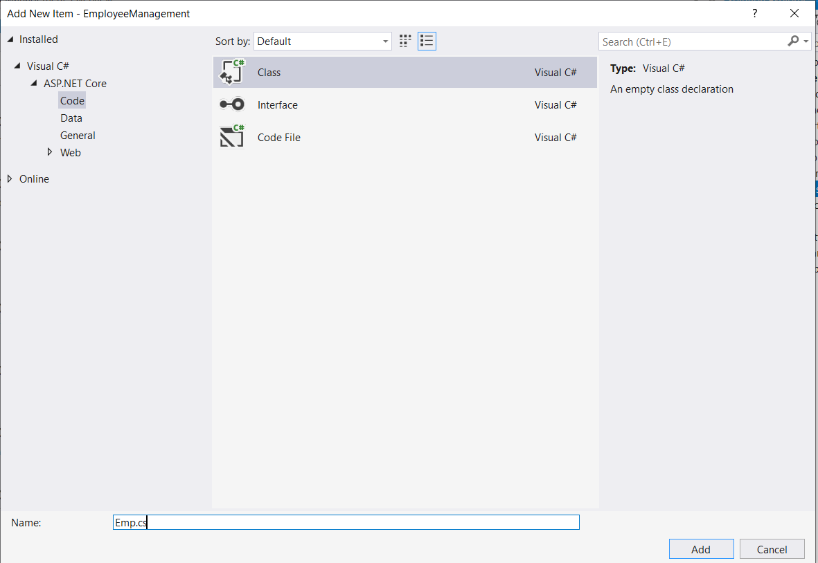

Slide 15
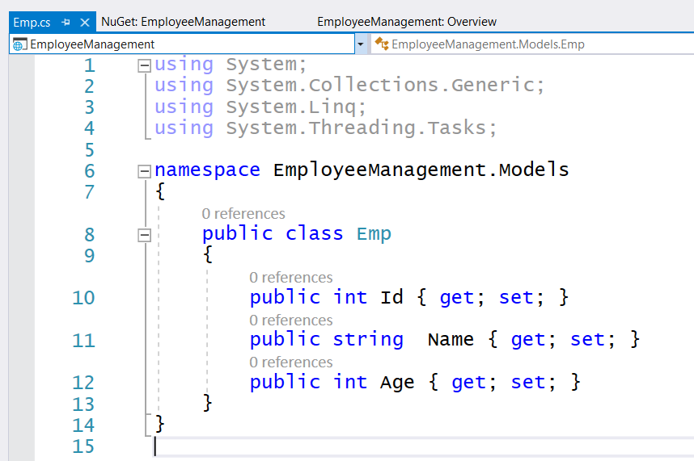

Slide 16
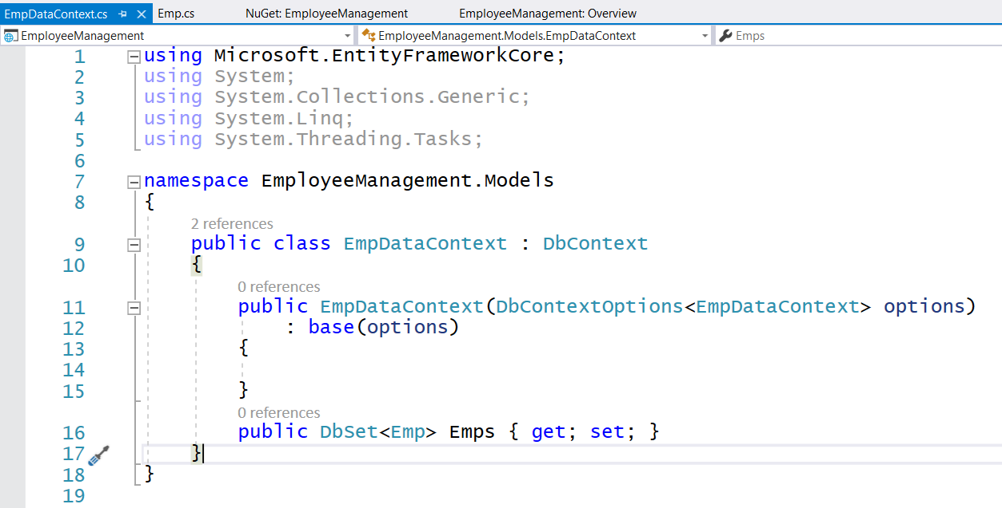

Slide 17
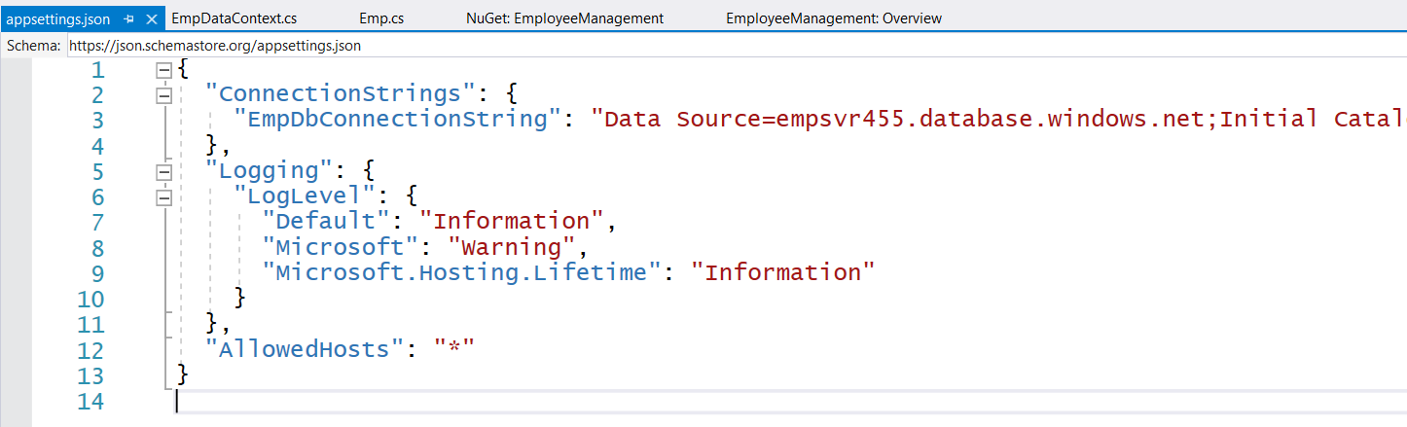
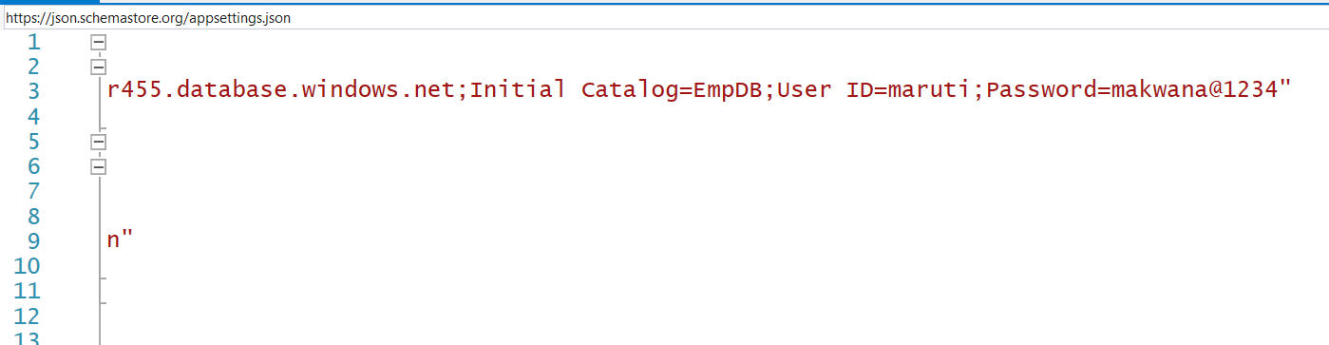

Slide 18
"EmpDbConnectionString": "Data Source=empsvr455.database.windows.net;Initial Catalog=EmpDB;User ID=maruti;Password=makwana@1234"

Slide 19
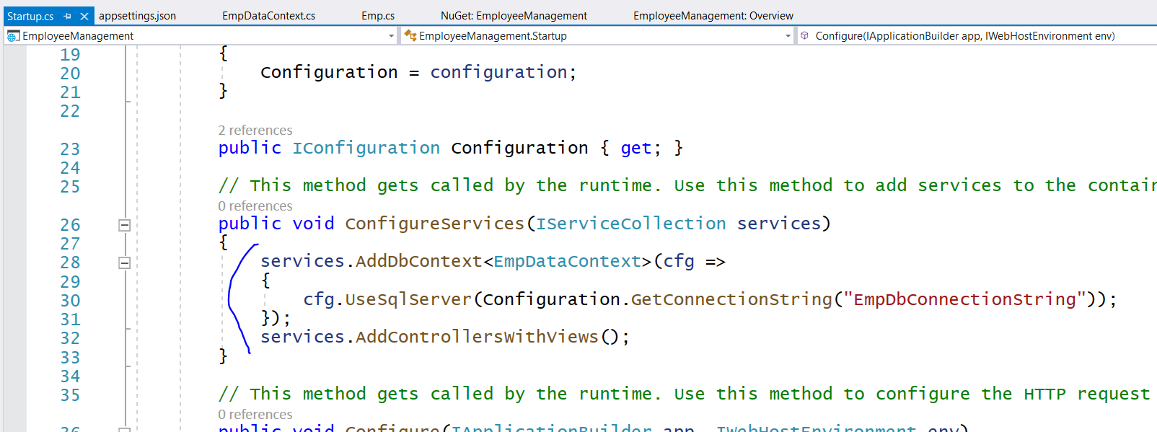

Slide 20
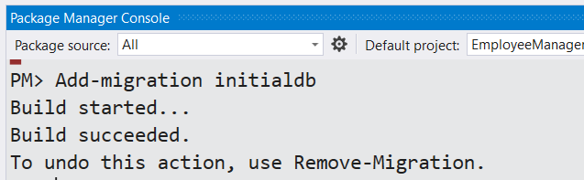
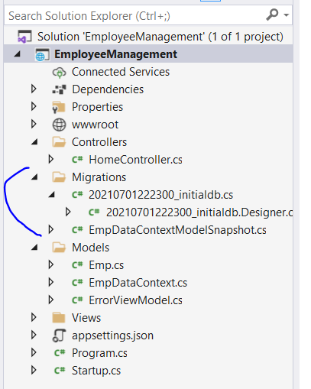

Slide 21
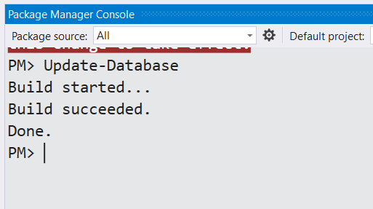

Slide 22
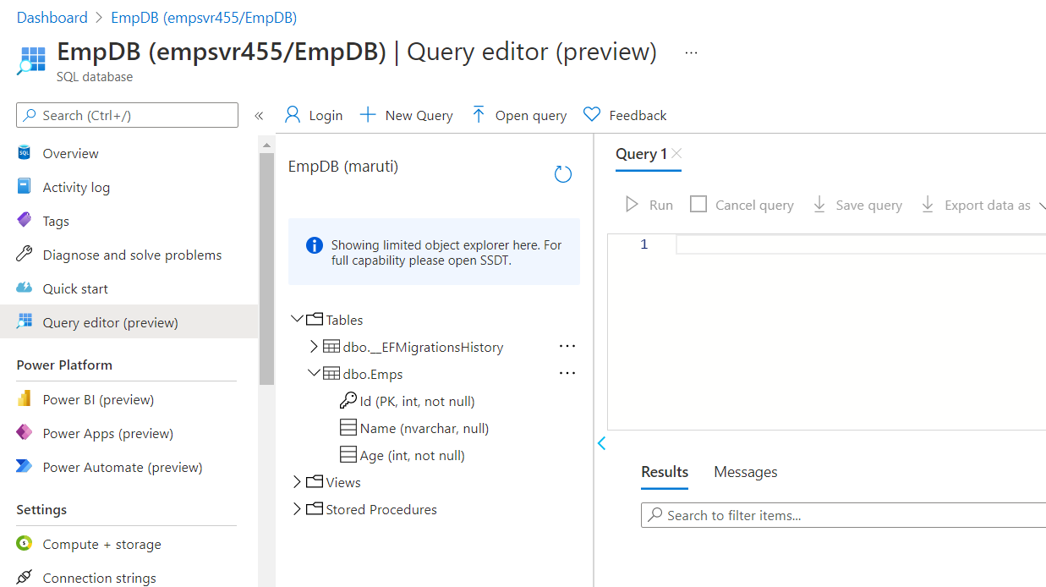

Slide 23
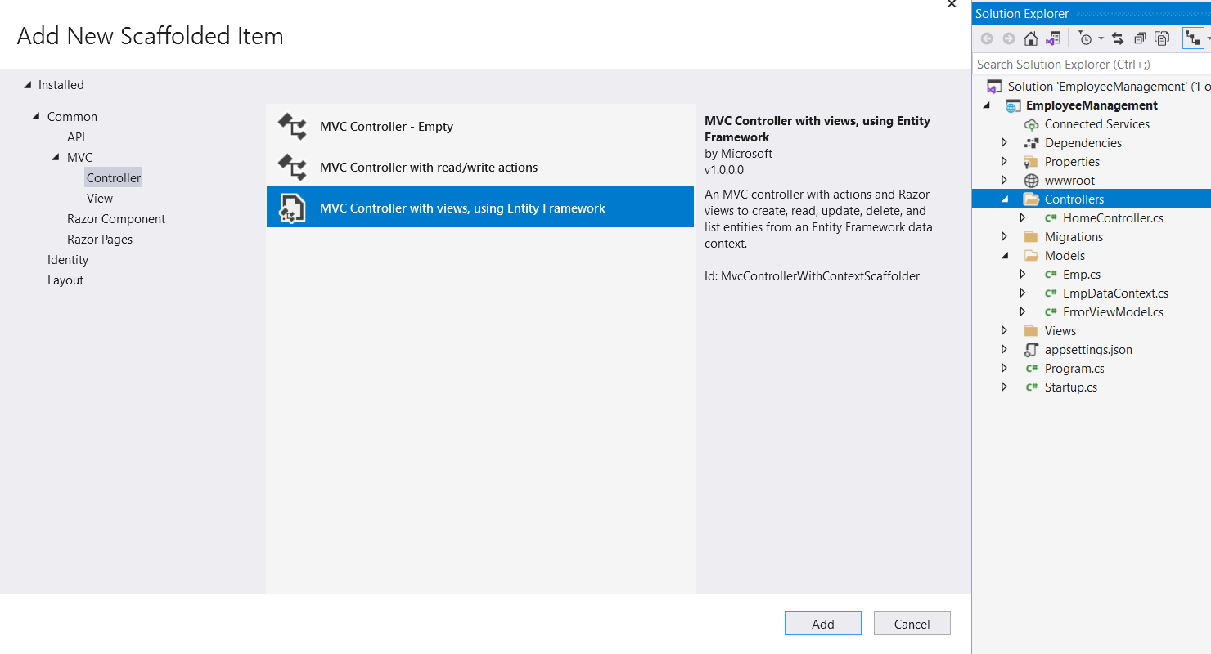

Slide 24
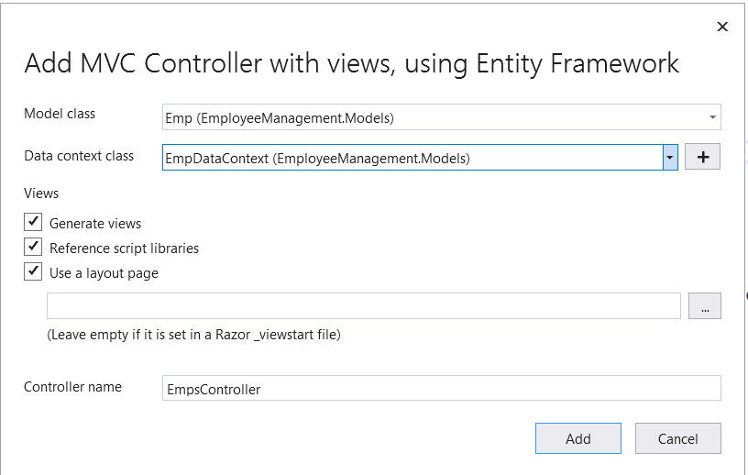

Slide 25
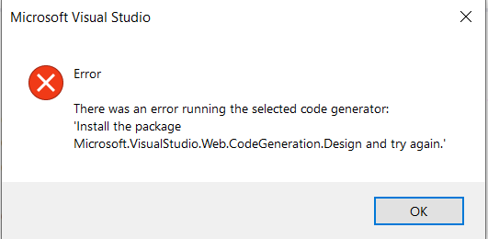
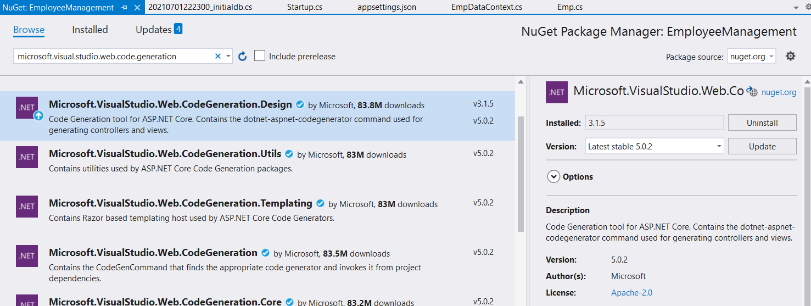

Slide 26
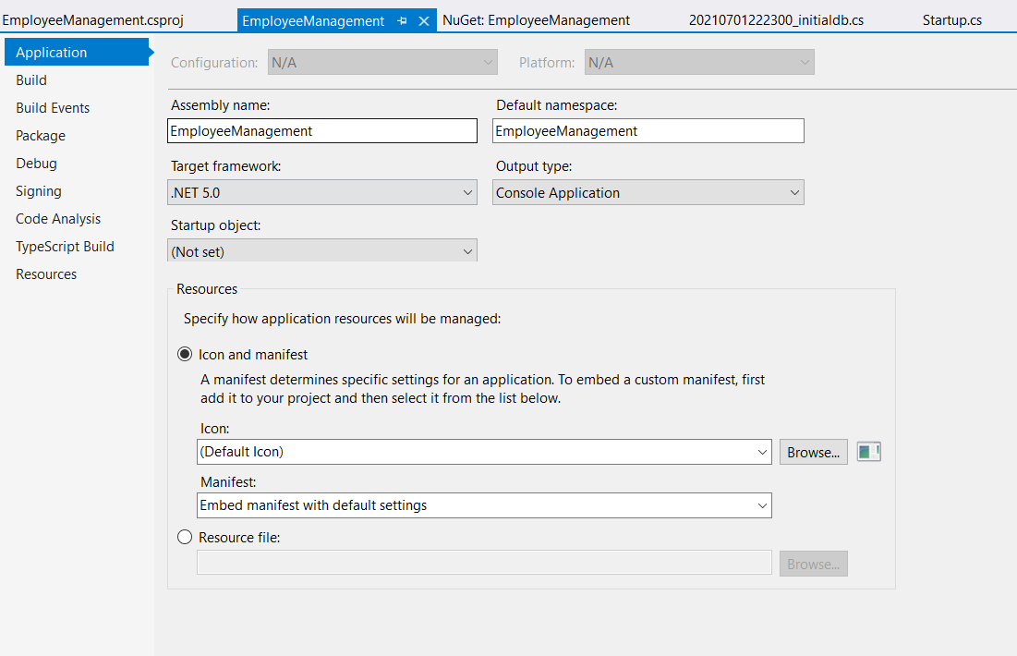

Slide 27
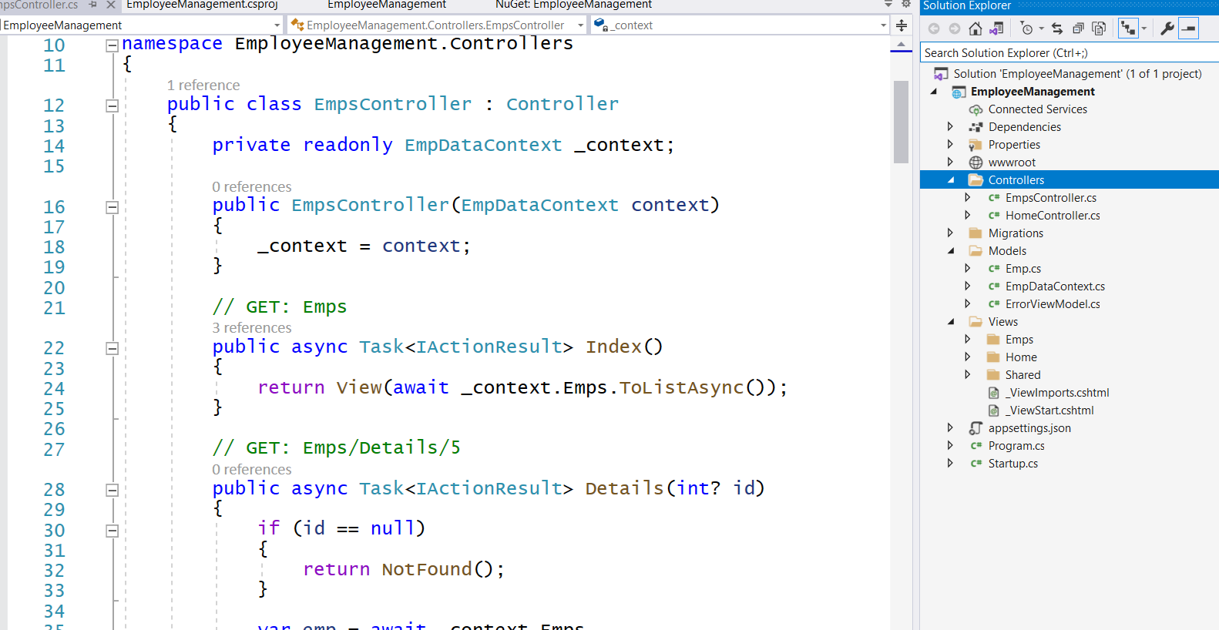

Slide 28
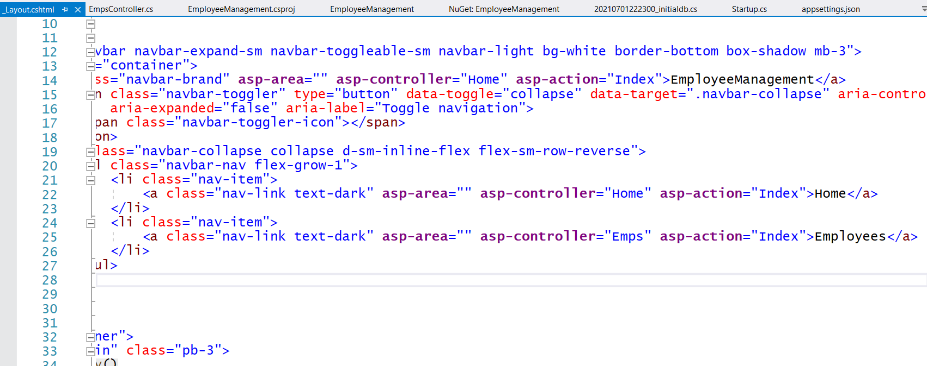

Slide 29
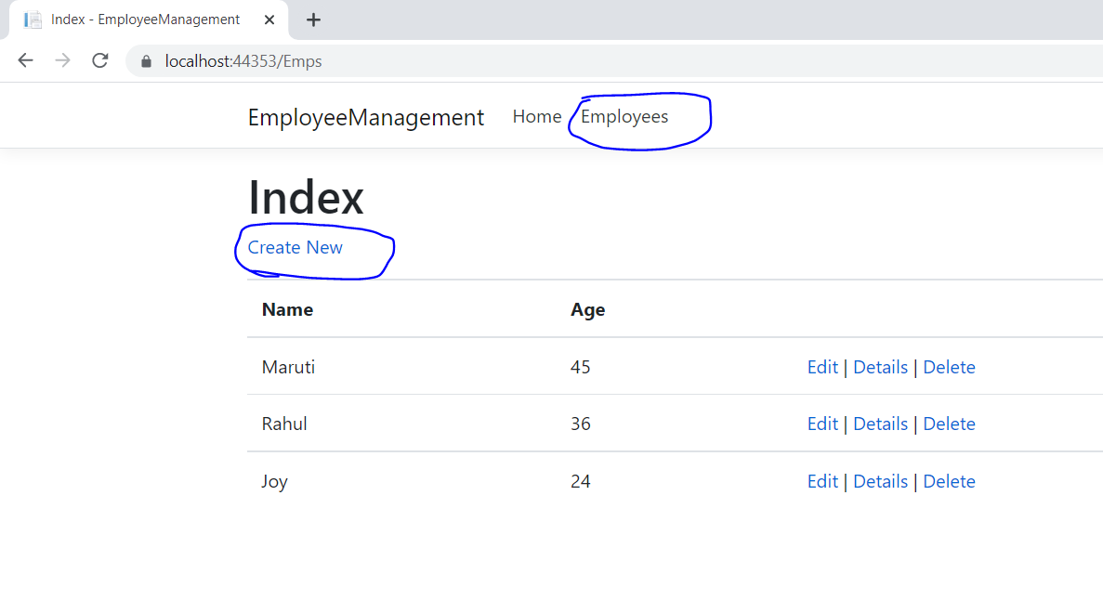

Slide 30
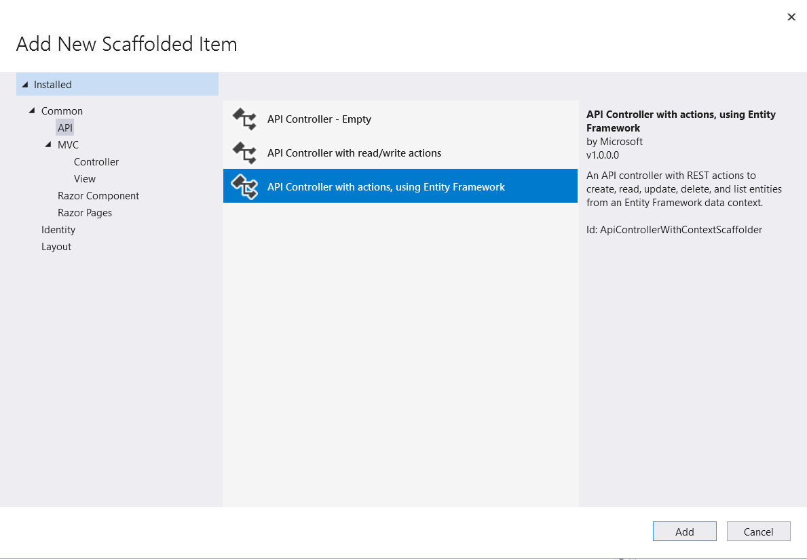
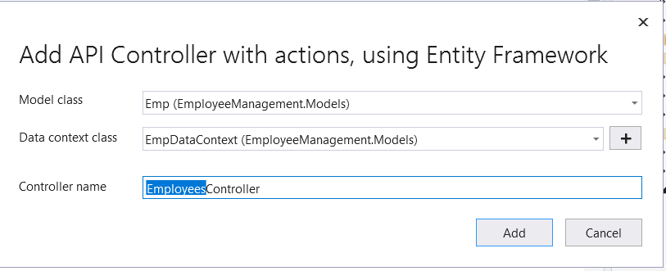

Slide 31
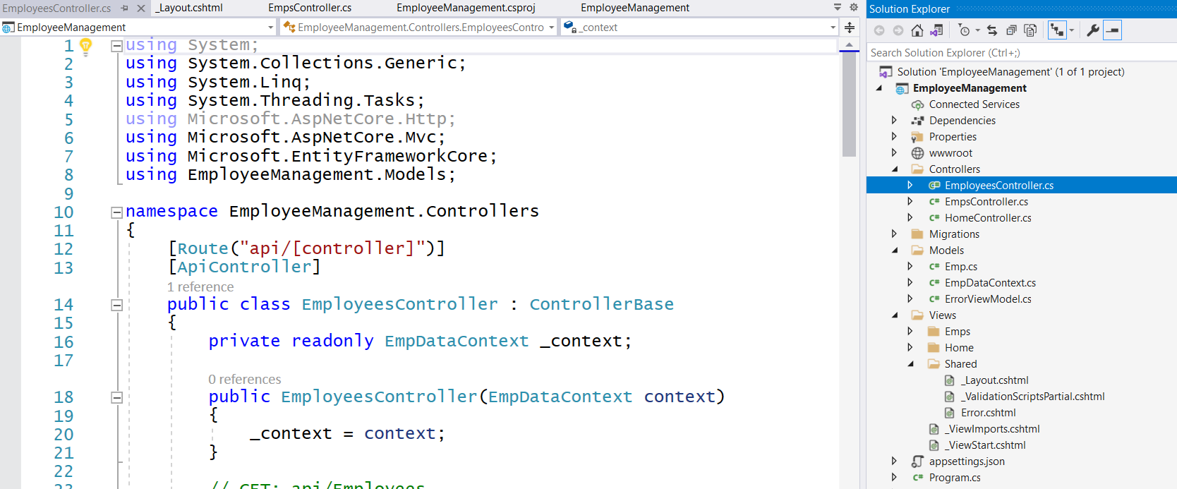

Slide 32
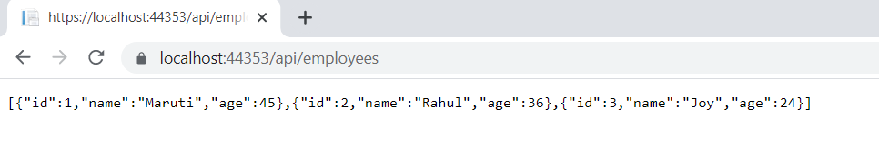

Slide 33
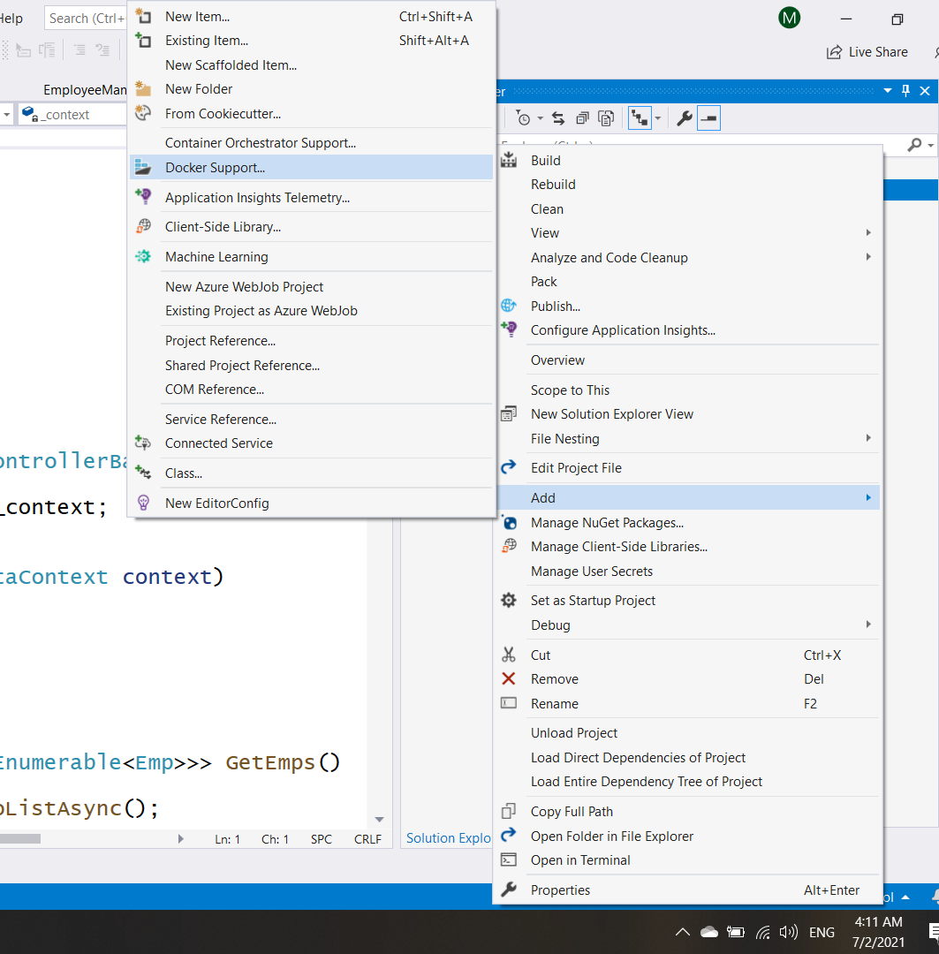

Slide 34
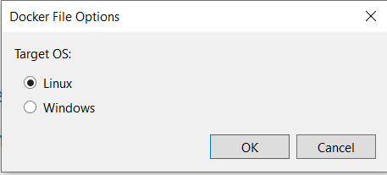

Slide 35
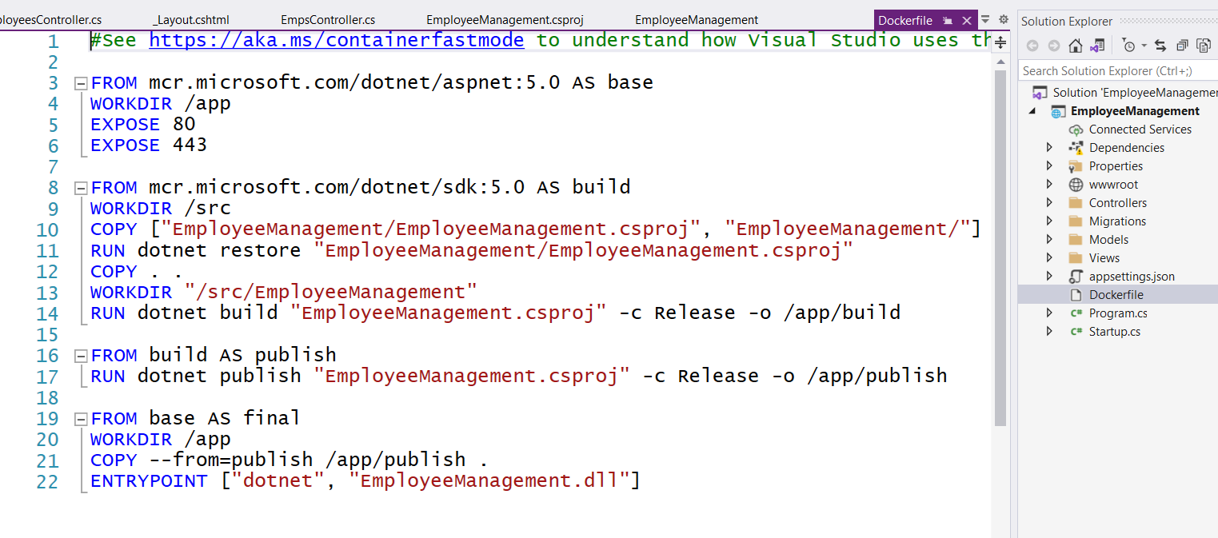

Slide 36
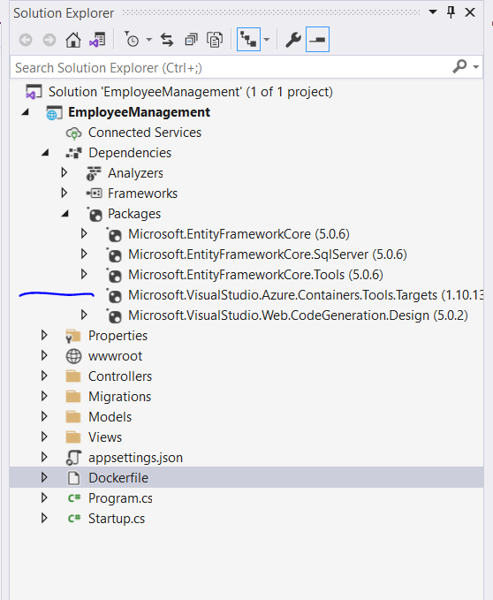

Slide 37
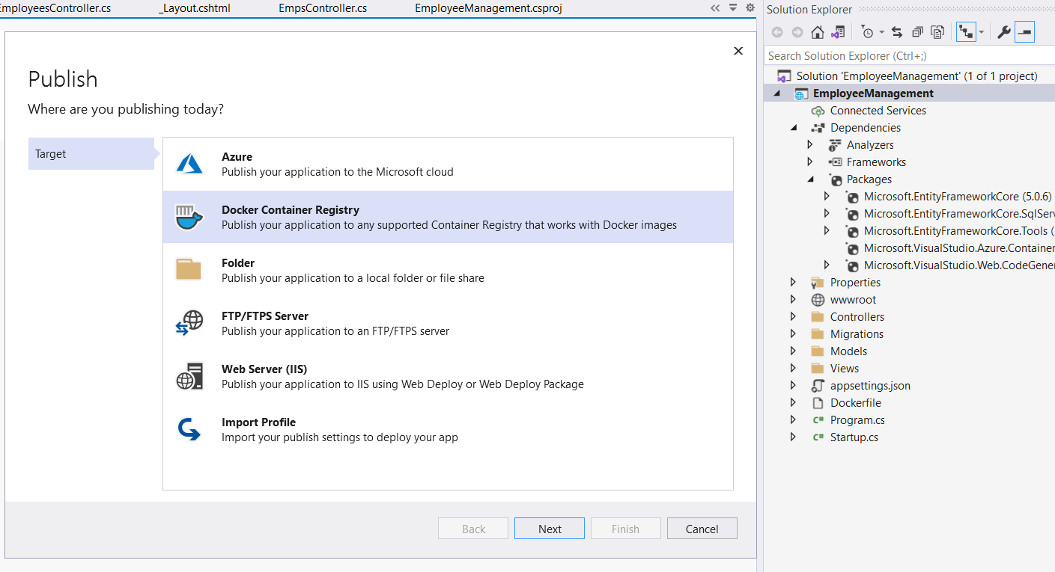

Slide 38
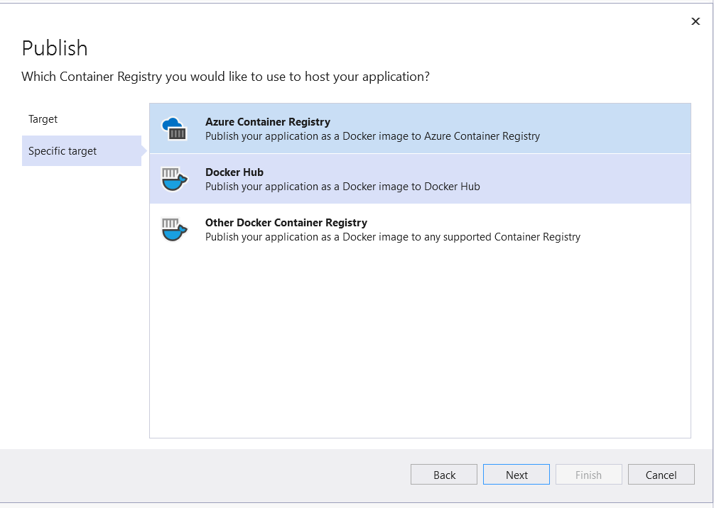

Slide 39
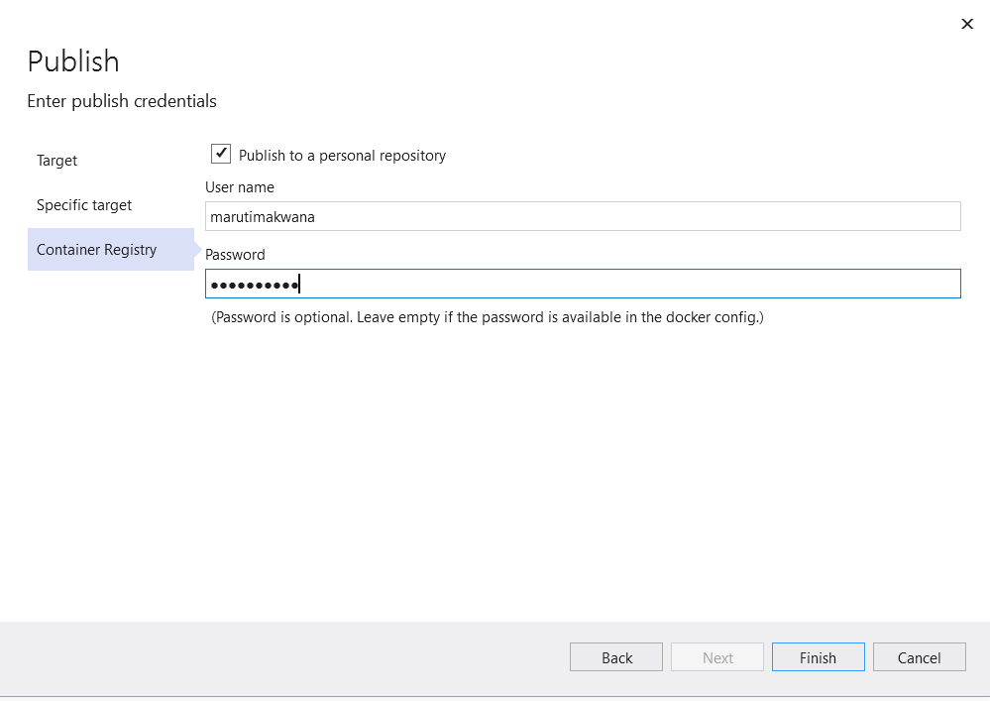

Slide 40
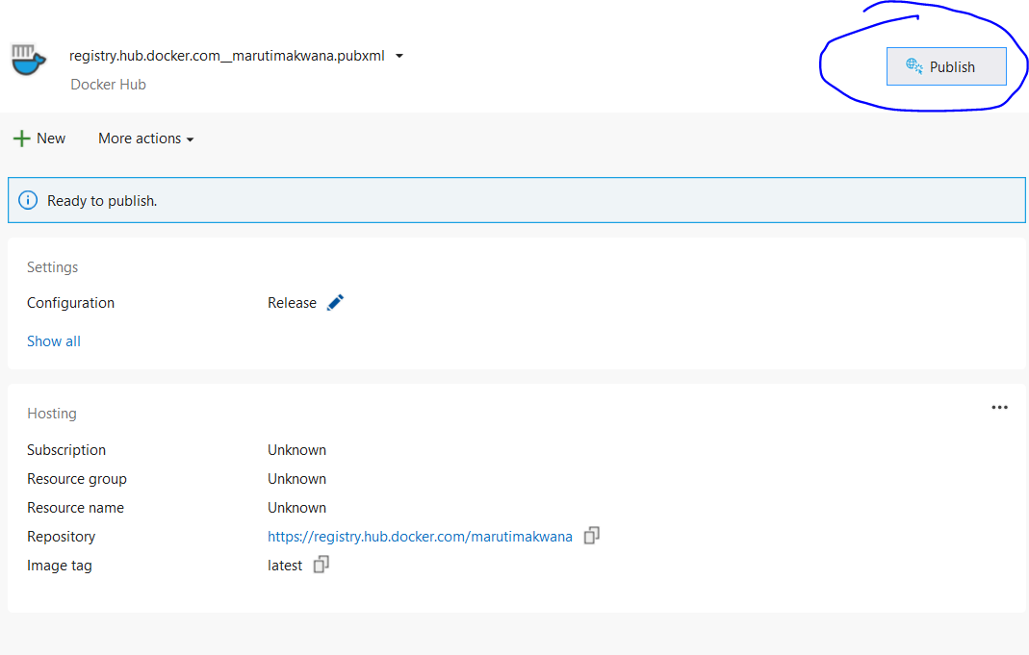

Slide 41
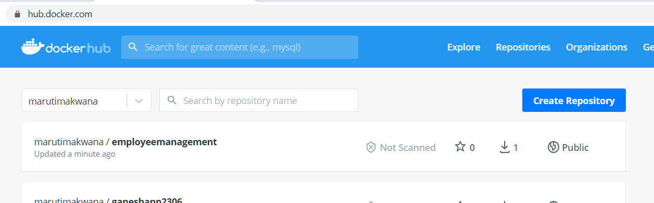

Slide 42
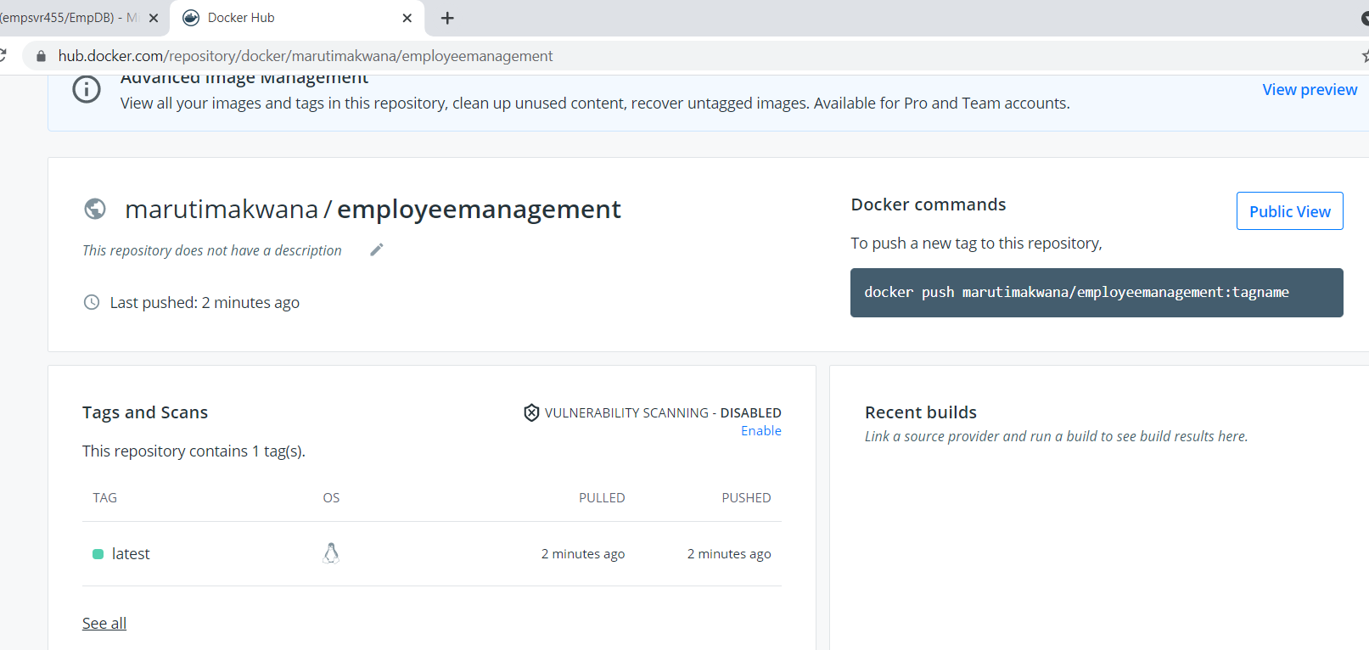

Slide 43
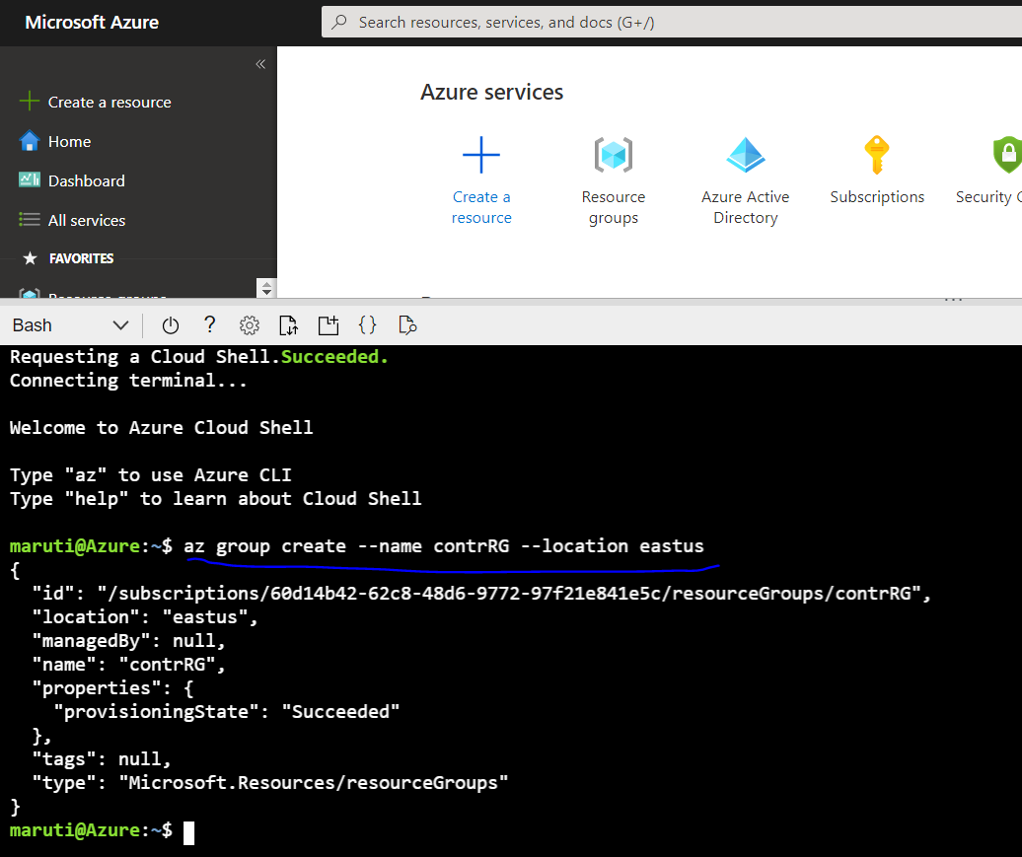

Slide 44
az group create --name contrRG --location eastus
az container create --name empapicntr --image marutimakwana/employeemanagement --resource-group contrRG --ip-address public

Slide 45
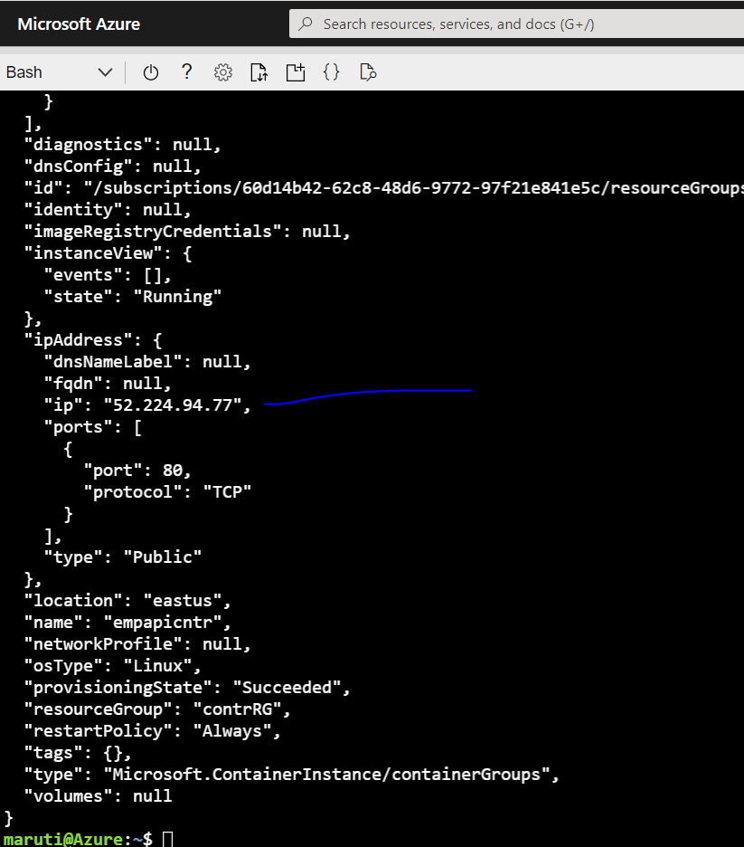

Slide 46
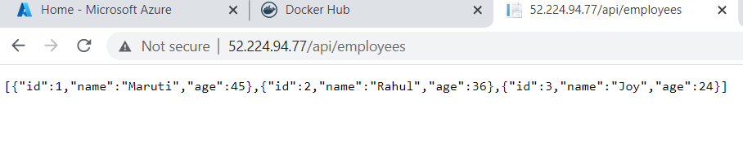

Slide 47
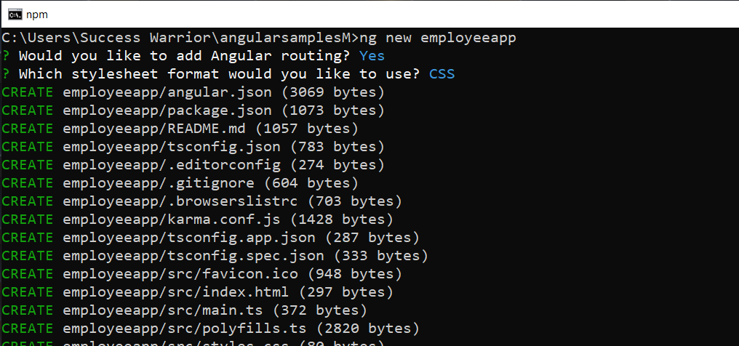

Slide 48
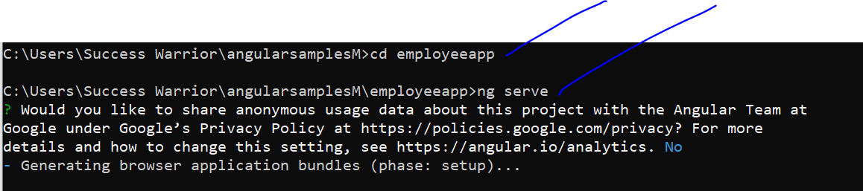

Slide 49


Slide 50


Slide 51

Make sure
Node_modules
Is not read only

Slide 52


Slide 53


Slide 54
# Stage 1: Compile and Build angular codebase
# Use official node image as the base image
FROM node:latest as build
# Set the working directory
WORKDIR /usr/local/app
# Add the source code to app
COPY ./ /usr/local/app/
# Install all the dependencies
RUN npm install
# Generate the build of the application
RUN npm run build
# Stage 2: Serve app with nginx server
# Use official nginx image as the base image
FROM nginx:latest
# Copy the build output to replace the default nginx contents.
COPY --from=build /usr/local/app/dist/employeeapp /usr/share/nginx/html
# Expose port 80
EXPOSE 80

Slide 55


Slide 56


Slide 57



Slide 58


Slide 59

docker tag image/employeeapp:latest marutimakwana/employeeapp457
docker push marutimakwana/employeeapp457

Slide 60


Slide 61


